Slide 1
Programming 4 - Intermediate Architecture
and Algorithms
Functional Programming with Python I
Semester 1, 2019

Slide 2
Functional programming principles
Functions are first class objects
Programs are stateless
Higher-order functions:
Map
Filter
Reduce
Partials/Closures
No looping
Notes:
These are the theoretical foundations of functional programming, and apply to any pure functional language
Programming languages with FP features will follow these principles to a lesser extent
FP languages such as Haskell, Scheme and ML are based in lambda calculus (or typed lambda calculus)
Loop constructs such as while and for statements don’t exist
In non-functional programming languages, a loop construct is primarily used for iteration, instead in lambda calculus, it’s uses recursion by using a function that calls itself

Slide 3
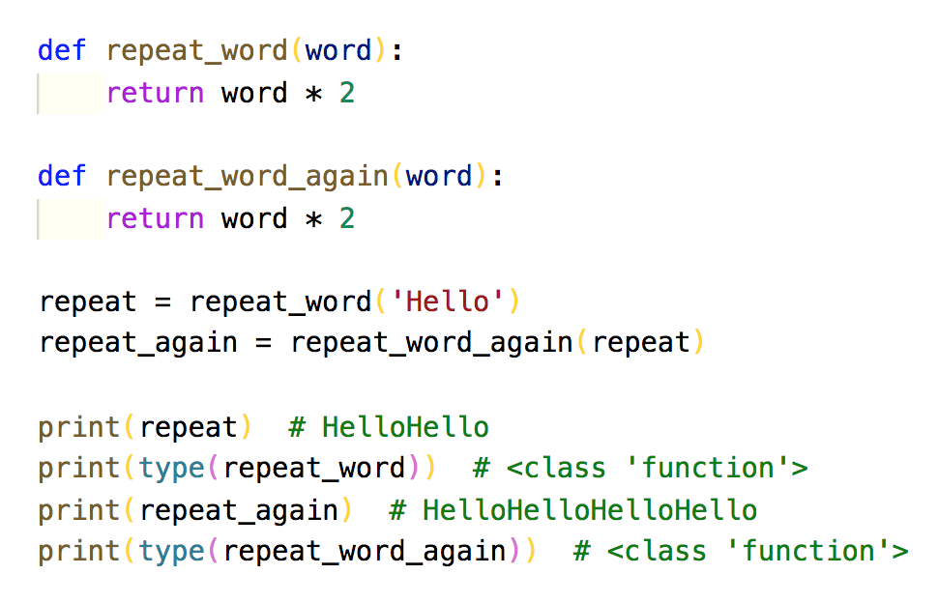
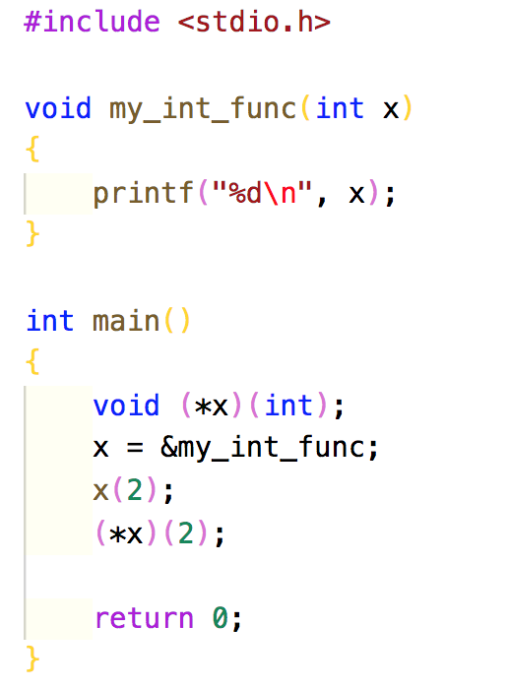
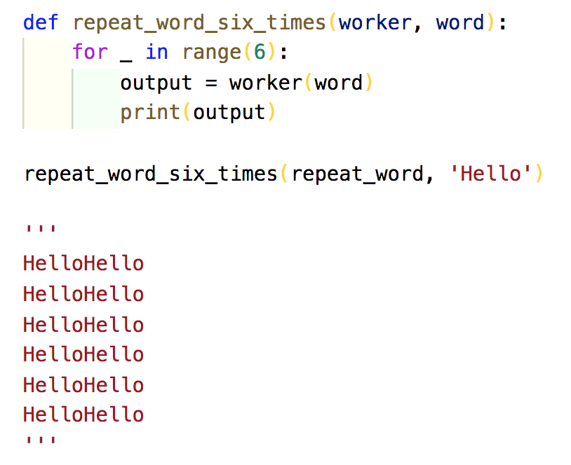
Functions as objects
Treat a piece of code like a piece of data
Assign to a variable
Pass to and return from another function
Create a high-order function
Notes:
JavaScript allows functions to be treated as objects
C++ allows “function-pointers” to be passed around
C# has a thing called ”delegates” that allows you to encapsulate a method and pass it around like an object
In Python, all functions start with the keyword def which means defining function
Since functions are treated as objects, you can do all the things you would usually do with objects
In most languages () is referred to the “call” operator. Note when don’t use () when assigning a function to a variable
When we assign a function to a variable, the type has changed from function to string – are you starting to understand the risks of loose typing?

Slide 4
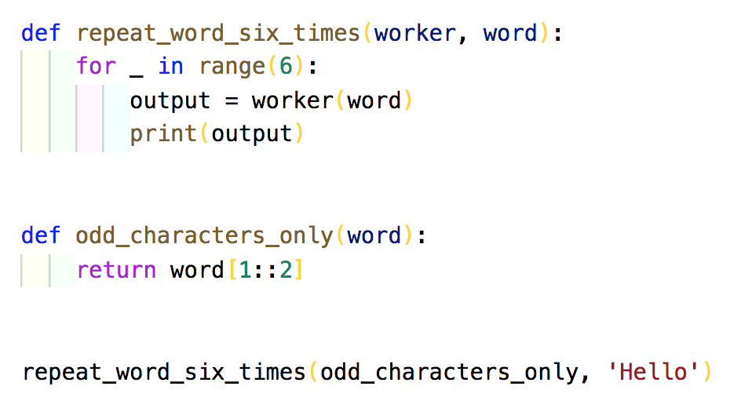
Functions as objects
Passing different worker functions
“Passing functions as arguments” works in complex scenarios

Slide 5
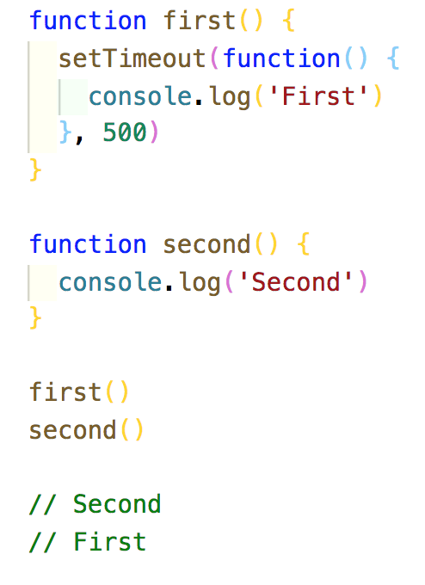
Functions as objects
Callbacks
Event-driven
Notes:
A function that is to be executed after another function has finished executing
JavaScript is an event-driven language meaning that instead of waiting for a response before moving on, JavaScript will keep executingwhile listening to other events

Slide 6
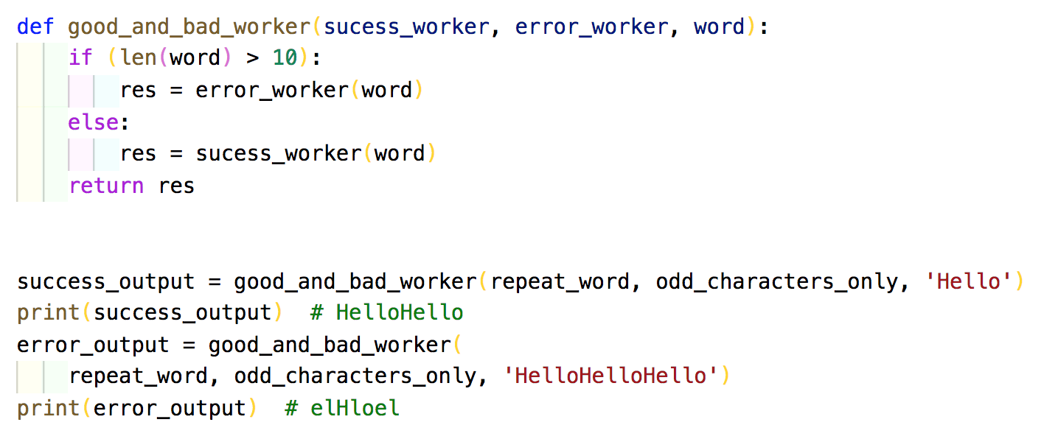
Functions as objects
Callbacks
Event-driven
Notes:
A function that is to be executed after another function has finished executing
JavaScript is an event-driven language meaning that instead of waiting for a response before moving on, JavaScript will keep executingwhile listening to other events

Slide 7
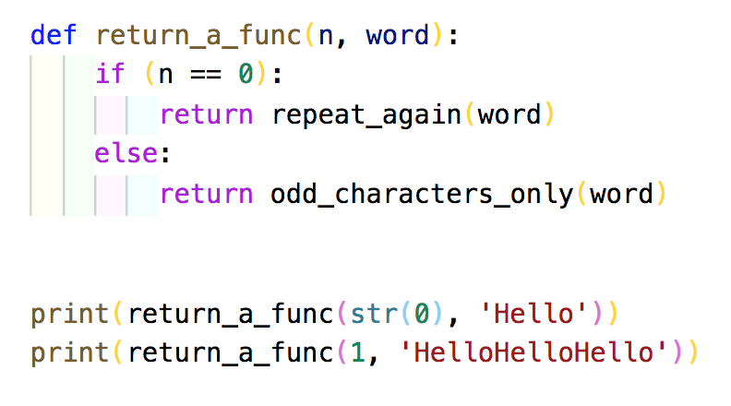
Functions as objects
Function returns
Fully dynamic
Notes:
This functionality is fully dynamic, so for example, you can decide which function to return based off user input

Slide 8
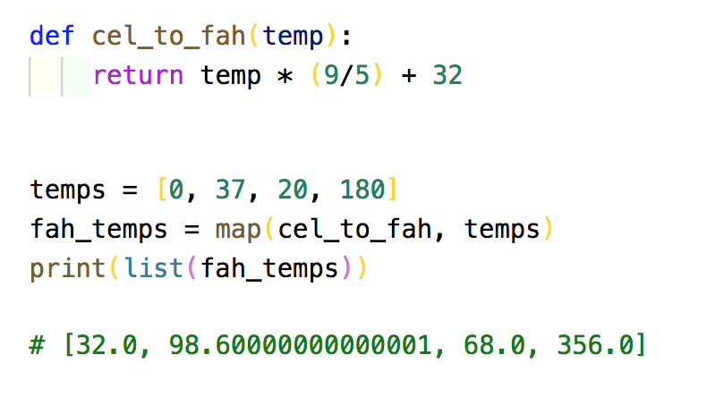
Map
Takes a worker function and a sequence
Built in function that accepts a function operator
An alternative to traditional for-loops
Notes:
Applies the function to each element of the sequence and returns a new sequence (of type map) consisting of all the results
Map returns a map object which is technically an iterator, not a list, so print wants it to be converted to a list
If you don’t cast list, the system prints “map object”
Map replaces the traditional for-loop that you would do in most languages
The result of map can be used as the input to other functions that are expecting a sequence

Slide 9
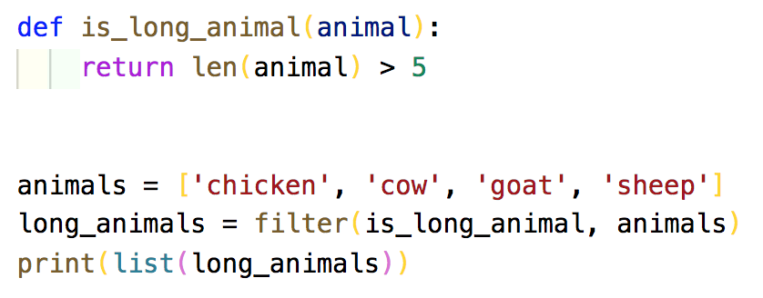
Filter
Takes a predicate function and a sequence
Predicate function – accepts one argument and returns a boolean
Notes:
You can easily implement the filter functionaility in an imperative language, but it would be much more verbose
We can use map and filter together
In FP, we don’t want intermediate state so we try to think of the whole process as just a pipeline of calls
Note that this style makes FP code, in general, much harder to read than imperative code
Code commenting becomes even more essential

Slide 10
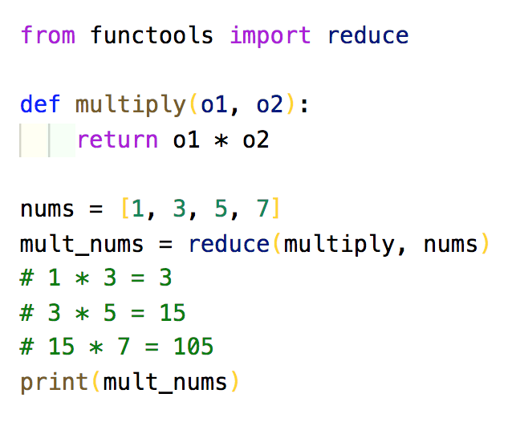
Reduce
Takes a function and a sequence
Function is applied to items one and two of the sequence
Function is then applied to the result of that step and item three…so on
At the end, only one value remains
Notes:
In Python3, reduce has been removed from the main library
Use functools library instead. This should go at the top of your file

Slide 11
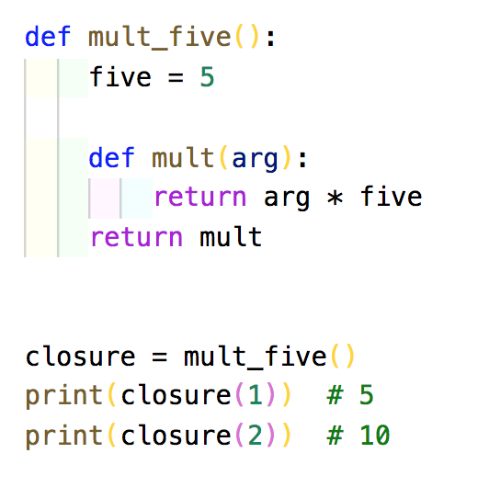
Partials/Closures
Keep alive a variable even when the function has returned
Call a function without supplying all the arguments it requires
Nesting a function inside the encapsulating function
Return the underlying function

Slide 12
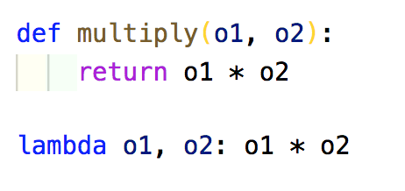
Lambda
Functions are defined anonymously
Lambda syntax – lambda calculus
Lambda sequence – variables: function code (with implicit return)
No def keyword
Notes:
Functions defined without a name
In situations where you just want to pass some worker logic into a higher-order function like map, filter and reduce, but don’t want to save it for later, you can define it anonymously on the fly

Slide 13
Lambda
Functions are defined anonymously
Lambda syntax – lambda calculus
Lambda sequence – variables: function code (with implicit return)
No def keyword
Notes:
Functions defined without a name
In situations where you just want to pass some worker logic into a higher-order function like map, filter and reduce, but don’t want to save it for later, you can define it anonymously on the fly

Slide 14
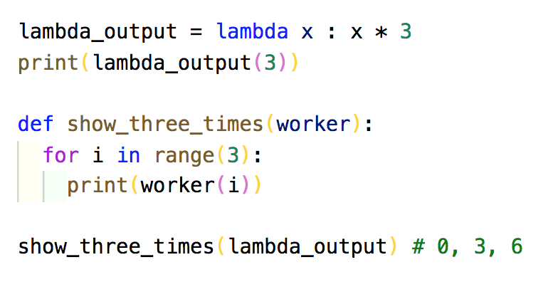
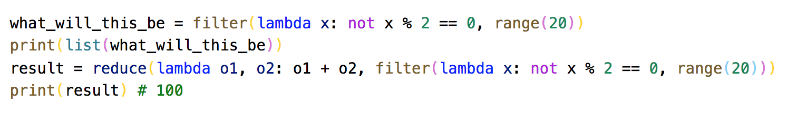
Lambda
Lambda assignment
Function passing
Can be used with other HOF
Do you see any downsides?
Notes:
Alternatively, you can pass the lambda instead of creating a separate variable
Could you write this same logic in C++ or Java? of course…would it be nearly succinct…no!
Do you see any downsides? For a person who doesn't know much functional programming, it would take a while to understand what the code is doing
We trade of brevity and readability

Slide 15
FP is not idiomatic Python
FP revolves around lists
Other than reduce and partials/closures, all functions generate lists
Guido van Rossum dislikes FP
Notes:
GVR dislikes functional programming in Python because Python already has its own way to generate lists

